Slide 1
Theatre Studies 1B: Theatre and Society
Elizabethan and Jacobean Theatre 1
Space and Place; Audience and Performers
Dr Vicky Price
Room 306, Gilmorehill
Office hours: Mondays 1pm-3pm
Email: Victoria.Price@glasgow.ac.uk

Slide 2
The idea of theatre as being both produced and consumed:
Who is producing/making the theatre?
Who are the intended audience?
Who is consuming the theatrical product?
How are the plays being consumed?

Slide 3
The theatre is space
- Anne Ubersfeld, 1981
A work is an object overflowing its frame
- M. Goulish, 2000

Slide 4
The building of the first permanent playhouses
James Burbage – The Theatre (1576)

Slide 5
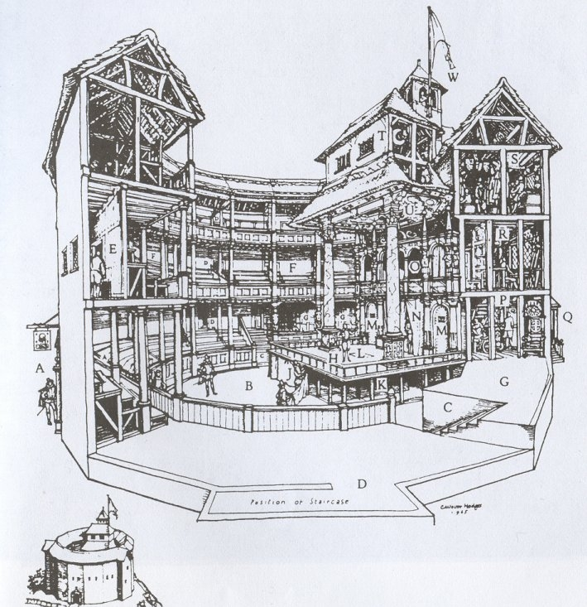

Slide 6
Reinforce ideas of social stratification
Interaction between actors and spectators
The proximity between actors and spectators means that not only do the audience watch the performers, the performers observe the audience, too.

Slide 7
But pardon, gentles all,
The flat unraised spirits that hath dared
On this unworthy scaffold to bring forth
So great an object. Can this cockpit hold
The vasty fields of France? Or may we cram
Within this wooden O the very casques
That did afright the air at Agincourt?
…Pierce out our imperfections with your thoughts:
Into a thousand parts divide one man,
And make imaginary puissance.
Think when we talk of horses, that you see them
Printing their proud hoofs I’the receiving earth.
Henry V Prologue 8-27

Slide 8
Suppose that you have seen
The well-appointed King at Dover pier
…O, do but think
You stand upon the rivage and behold
A city…Work, work your thoughts, and therein see a siege
…And eke out our performance with your mind.
Henry V III. Chorus 3-35

